Slide 1

TASK 2
Predicting customer buying behaviour

Slide 2
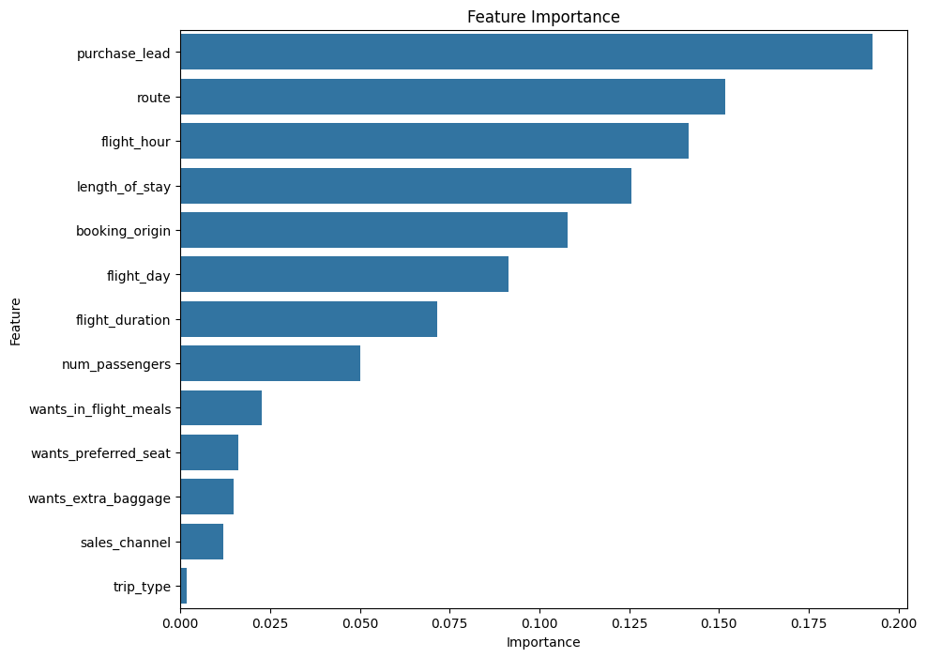
The feature importance chart illustrates the critical factors in predicting customer buying behavior. "Purchase lead," "route," and "flight hour" are the most influential predictors. These insights empower airlines to anticipate customer decisions and tailor their marketing strategies accordingly, improving customer acquisition before they even consider alternative options.

